Slide 1
Intro to R, Descriptive Statistics, and Data Visualization

Slide 3
Installing R and RStudio
What you need:
http://www.cran.r-project.org/ ← Download R (Free version)
http://www.rstudio.com/download ← Download Rstudio (Free version)

Slide 4
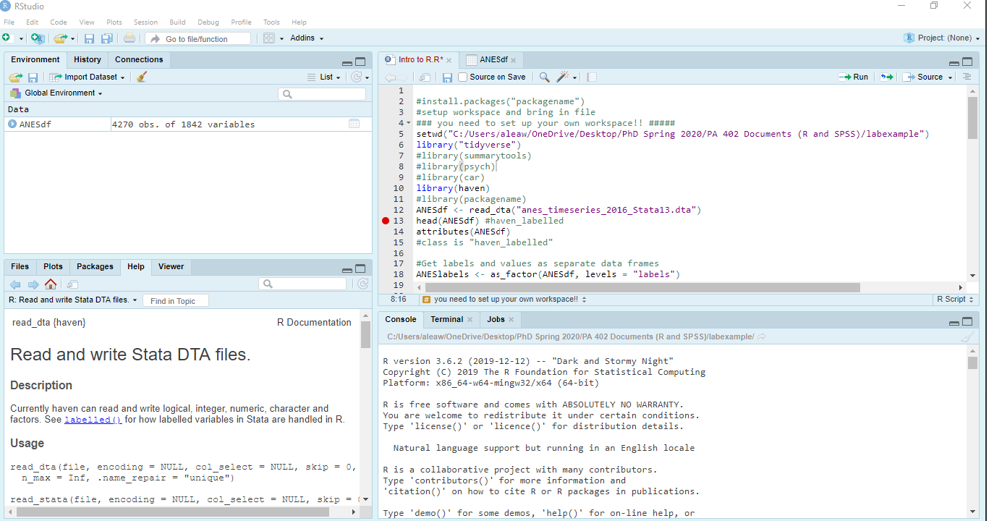
Environment / History
File Viewer / Editor
Files/Plots/etc.
Console
Notes:
Each time R is opened, a new “Session” starts. You can change the color scheme and layout in Tools > Global Options > Appearance or View > Pane Layout > Arrange the way you want.
The file viewer. Here you can write your code in a script file for safekeeping and reuse or look at your data in spreadsheet format. When you want to look at more than one file at a time, you can view them in a separate window.
The console. This is where you enter code and see the output. You can either type out your code here or highlight code in the file viewer and use a keyboard shortcut to have it automatically entered.
The environment viewer. This just shows you a list of all the objects that are currently in R’s environment..
Files/Plots/Packages/Help. Does a wide range of things and it is customizable.

Slide 5
PPOL 105: Intro to R

Slide 6
Scope
Why R?
Installing RStudio
Environment and layout of RStudio
Packages and basics
R markdown

Slide 7
Why R?
It’s FREE!!!
Can perform any type of analysis
Aesthetically-appealing graphics
Provides flatter learning curve for understanding Stata, SPSS, etc.
Learning R code allows for easier learning of other programming languages (e.g., Python)
Highly desired skill for job market
Magic of R markdown

Slide 8
Installing R and RStudio
First, install R: https://cran.r-project.org/
Follow instructions for operating system
Second, install RStudio: https://www.rstudio.com/
Follow instructions for RStudio desktop: Open Source License
Follow instructions for operating system

Slide 9
Environment and layout of RStudio
Console window: code and results
R Script window: R code
Workspace browser:
Environment: datasets, values, functions
History: used commands
Bottom-right collection:
Files: files in current directory
Plots: graphics
Packages: installed R packages
Help: R help information
Viewer: locate web content

Slide 10
Environment / History
File Viewer / Editor
Files/Plots/etc.
Console
Notes:
Each time R is opened, a new “Session” starts. You can change the color scheme and layout in Tools > Global Options > Appearance or View > Pane Layout > Arrange the way you want.
The file viewer. Here you can write your code in a script file for safekeeping and reuse or look at your data in spreadsheet format. When you want to look at more than one file at a time, you can view them in a separate window.
The console. This is where you enter code and see the output. You can either type out your code here or highlight code in the file viewer and use a keyboard shortcut to have it automatically entered.
The environment viewer. This just shows you a list of all the objects that are currently in R’s environment..
Files/Plots/Packages/Help. Does a wide range of things and it is customizable.

Slide 11
Installing and using R packages
R packages contain different R functions: core set downloaded with R; otherwise need to download
Need packages installed and activated/loaded to use certain R functions
Install once using:
install.packages(“nameofpackage”)
Load/activate each R session:
library(nameofpackage)

Slide 12
R markdown
Combines R code and output with text in one document
Can use to create Word & PDF documents (as well as websites, interactive documents, etc.)
Instead of .R file, it is .Rmd file in Rstudio
Worth the effort in learning!

Slide 13
Making RStudio Work: Install Packages
install.packages(“packagename”) #installs on computer- only need to do this once
library(“packagename”) # loads the package into your workspace
install.packages(“tidyverse”) #contains dplyr, ggplot, tibble, readr, tidyr, purr
install.packages(“haven”) #can read SPSS and Stata files.
library(“tidyverse”)
library(“haven”)
Notes:
Fogarty pg 17

Slide 14
Open Datafile
Open file in R
Can use either File > Import > Select Data Type > Select Data File
Can type the command read_dta()
ANESdf <- read_dta("anes_timeseries_2016_Stata13.dta")
If the file is in your workspace
Otherwise, include the whole path to the file location, see below
ANESdf <-read_dta("C:\Users\username\Desktop\folder\PA402\anes_timeseries_2016_Stata13.dta")
Reads the .dta file and stores it as a new data frame in R, named ANESdf.
Name it something short but descriptive
Dataframe should now exist in the R Environment tab. Click it. What do you see?
Notes:
Mac users do not need the .dta extension at the end of the file name !!

Slide 15
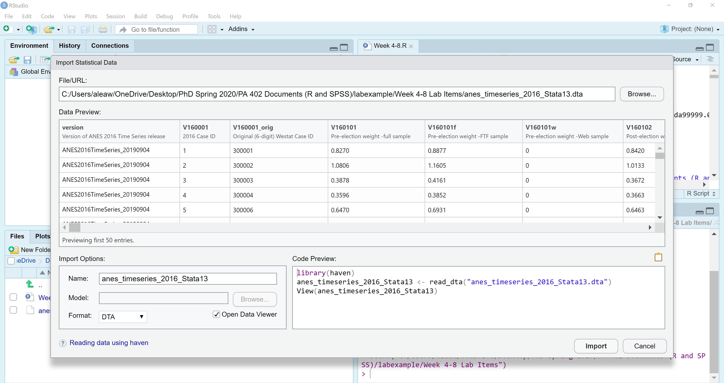
Notes:
File > Import > From Stata> Browse for file you want
You can rename it in this interface too in the “Import Options” area. I did not do that in this image.

Slide 16
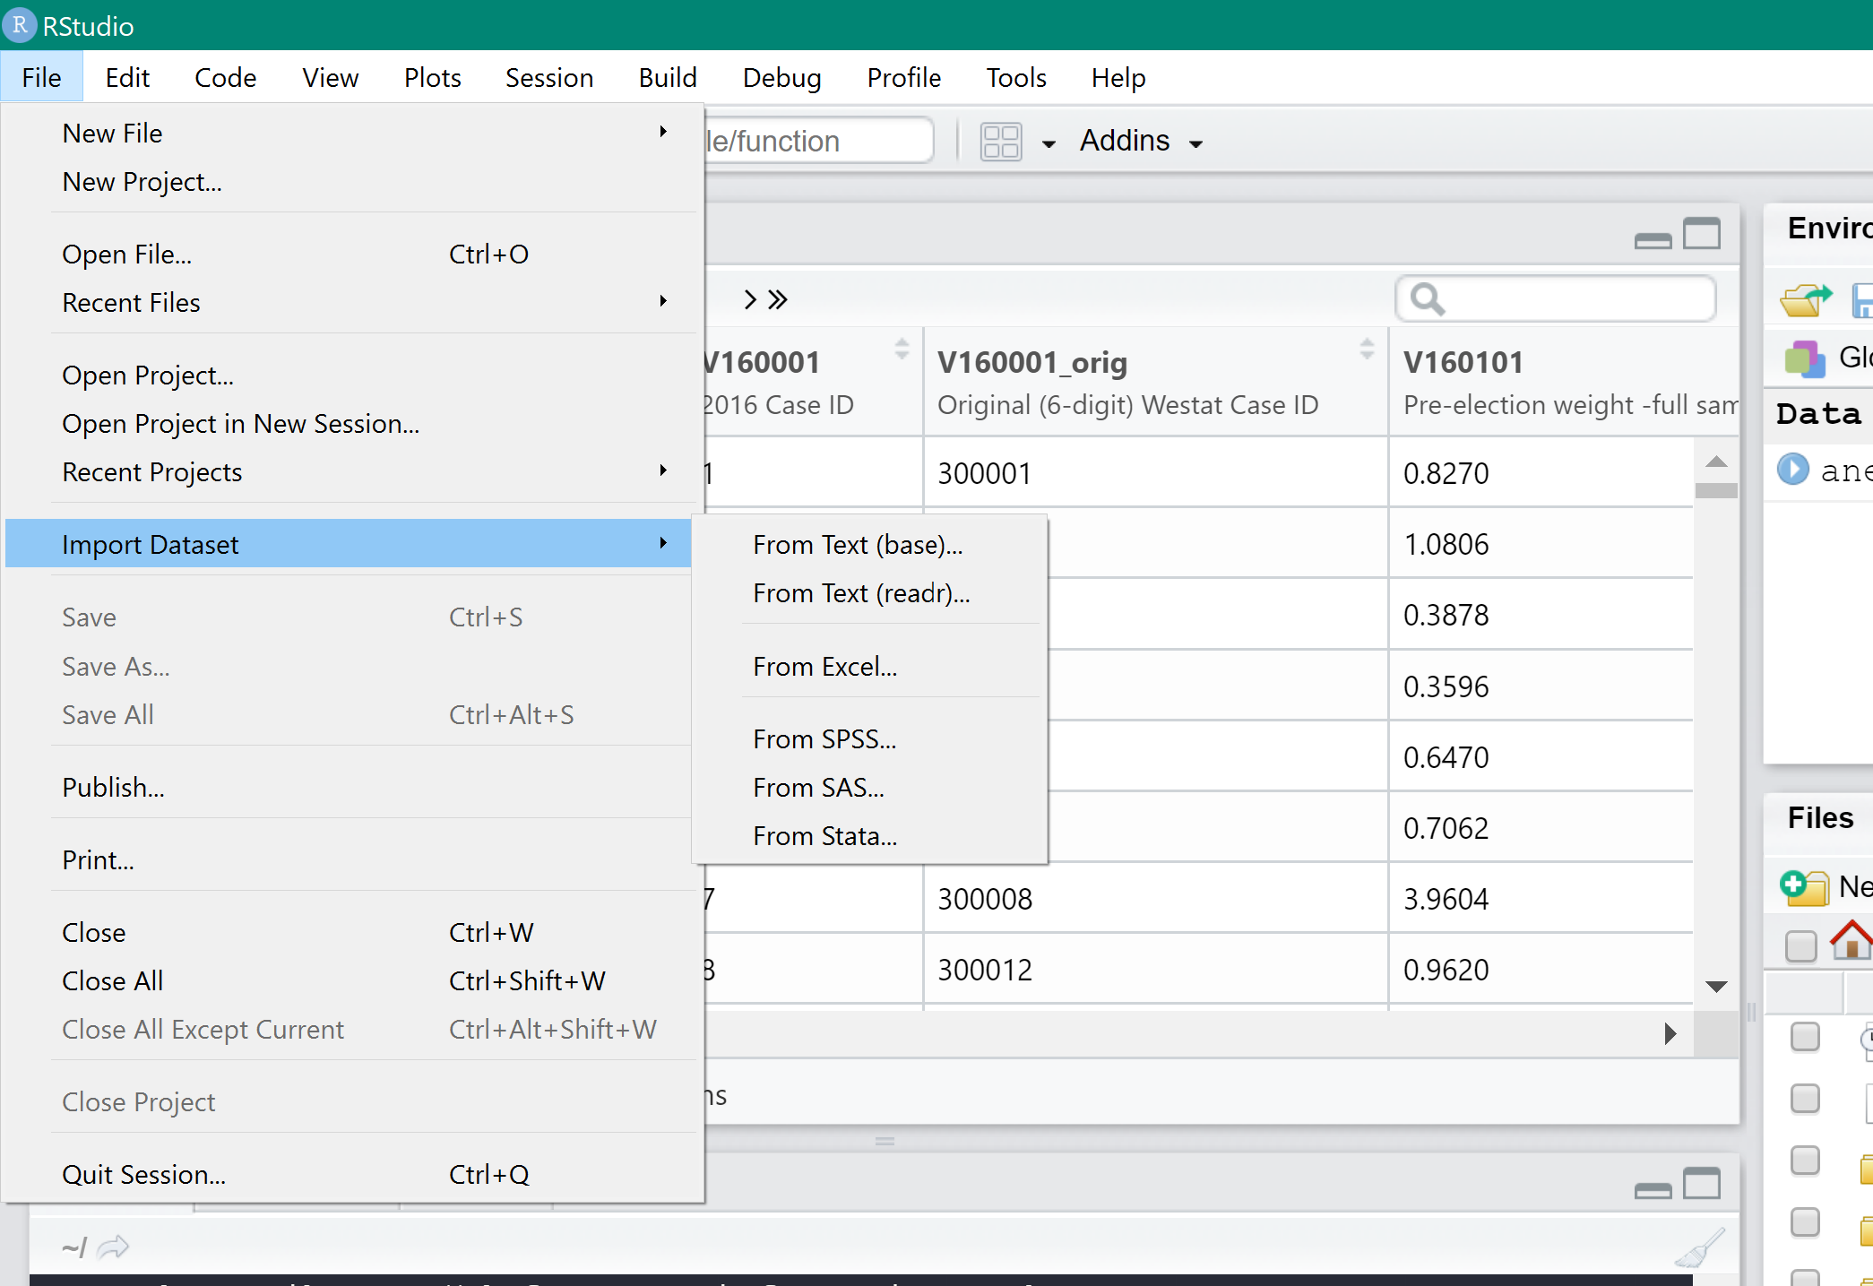
You can also use menus to important data files:
Can import multiple file types
.csv or .xlsx
.sas
.sav
Text
Or Open File → the file you want to use
Notes:
You can do this, but it doesn’t always work the way you want or only works for certain file types.

Slide 17
Levels of measurement
Determines the appropriate types of statistics and modelling for analysing variables
Four levels:
Nominal – categorical variables with no order to the values
Ordinal – categorical variables with order to the values, but difference between values is meaningless
Interval - variables with order, difference between values matter, but 0 does not mean attribute does not exist
Ratio – same as interval variables, but 0 means attribute does not exist

Slide 18
Levels of measurement: examples
Nominal-level variables:
Gender
Race
Ordinal-level variables:
Education level
Approve/disapprove survey questions

Slide 19
Levels of measurement: examples
Interval-level variables:
Feeling thermometers
Ratio-level variables:
Raw income
Number of murders

Slide 20
Indexes and scales
Indexes: combines several related items or variables to measure a complex social science concept
Weights all items equally in final measure
Scales: similar to indexes, but weights to reflect contribution of items/variables in final measure
Likert-scale: most common
Widely used in social and personal behaviour research (e.g., psychology)

Slide 21
Recoding variables: labelling
Labelling variables:
Best to have variable name be meaningful, so don’t require a label
For example, “income” instead of “incR”…
Labelling variable values:
Informative for self-understanding of variables
Important for plotting and graphing
Can do in R with car() and plyr() packages

Slide 22
Recoding variables: reverse recoding
Sometimes variables are coded in less intuitive and useful ways
For example,
We need to have all variables in a scale have the same direction of values
Or, as a variable’s values get larger, the attribute is actually decreasing:
“1 = greatly increase immigration” … “5 = greatly decrease immigration”

Slide 23
Recoding variables: reverse recoding
Or, we want a set of variables’ values to indicate the same direction
To fix the problem, we reverse recode the values; flip the values

Slide 24
Recoding variables: collapsing
Involves taking a variable with many values and recoding to only have a few
Generally, prefer to not collapse, but may need to for analysis or presentation purposes
Best if collapsed version has equal number of categories from original variable
For example,
Collapse age in years to age by categories
1–10, 11–20, 21–30,…

Slide 25
Recoding variables: dummy/indicator variables
Nominal-level variable with only two values – 0 and 1
“1” indicates attribute is present, “0” indicates attribute is not present
For example, a variable called female, where “1 = respondent is female” and “0 = respondent is male”
Often, we must dummy nominal variables with multiple categories; many analysis techniques assume order to values

Slide 26
Recoding variables: dummy/indicator variables
For example, using US region variable
Single dummy variable: south, “1 = US south”, “0 = rest of US”
Several dummy variables: south, “1 = US South”, “0 = rest of US”; northeast, “1 = US Northeast”, “0 = rest of US”; west, “1 = US west”, “0 = rest of US”
Complete dummying: create dummy variables for all values except one (which serves as the comparison group)

Slide 27
Recording variables: transformations
Sometimes need to arithmetically transform variables for statistical or substantive reasons
This includes squaring, cubing, natural log, etc.
Can perform transformations by creating new variables:
Age-squared = age*age
Can also use the I() function in R; carries out transformation without creating a new variable
I(age^2)

Slide 28
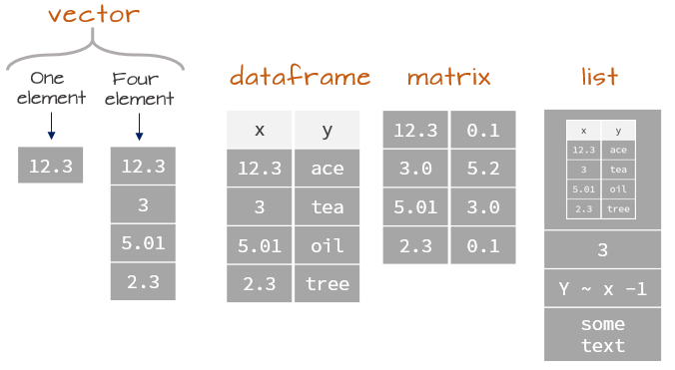
Types of Objects: Vectors, Matrices, and Data Frames
Vector = one-dimensional collection of data, can be a row OR column.
Data Frame = a type of matrix. Think of it like an excel file.
Matrix = combination of columns and rows. At least 1 of each.
Data sets are most often organized with variables in columns (ID number, age, evaluation of President’s performance, etc.) and unit of analysis (people, organizations, observations) in the rows.
Notes:
Vector = one-dimensional collection of data, can be a row OR column.
Matrix = combination of columns and rows. At least 1 of each.
Data Frame = a type of matrix. Think of it like an excel file.
Columns of a data frame are variables

Slide 29
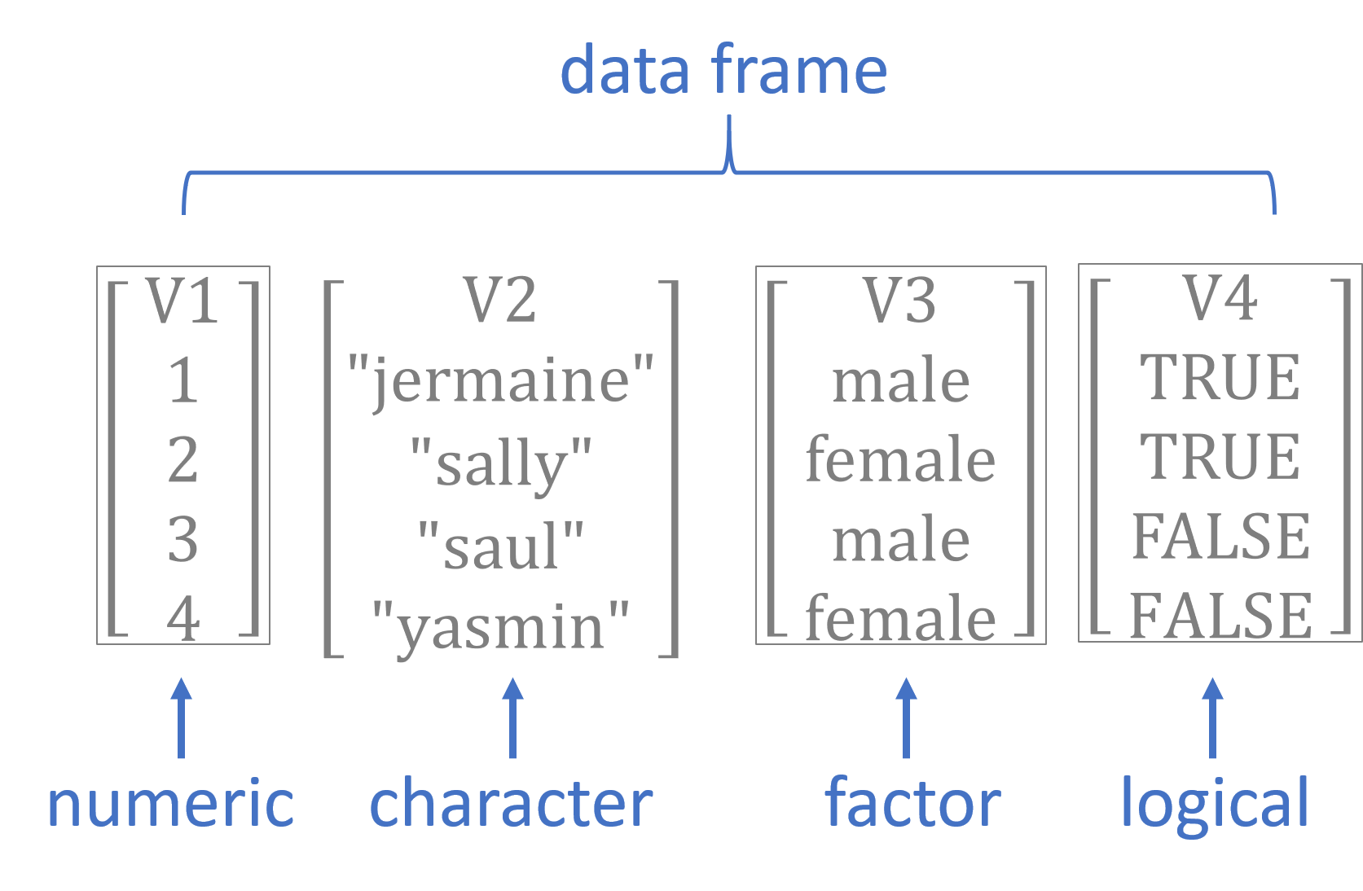
Types of Data & Levels of Measurement
Nominal = logical (binary), factor (categorical)
No Order (ex. race, religion, etc.). Numbers assigned don’t have actual meaning
Ordinal = numeric
has general sense of increasing or decreasing order, but the distances between categories aren’t meaningful
Ex. 1 = high school diploma, 2 = undergraduate degree, 3 = masters degree
Number of years to get each one are all different
Not a form of measurement
Notes:
Discussed more in Week 3

Slide 30
Levels of Measurement: Interval vs. Ratio
Interval = numeric
Has order, Distance between numbers has meaning, 0 is arbitrary
Ex. Temperature in C or F, feeling thermometer survey questions
Ratio = numeric
Same as interval, but 0 implies an attribute does not exist
Ex. Movement of 0 mph, salary of $0,
Not a form of measurement
Notes:
Week 3

Slide 31
Factors, Levels, Values, and Labels
dataframe$variable <- factor(dataframe$variable, levels = 1:5 , labels = c( 'Excellent' , 'Very Good' , 'Good' , 'Fair' , 'Poor’ ))
# levels = the number of options for each variable
Like a multiple choice test (A, B, C, D or 1,2, 3, 4)
# labels = the word that is glued to the value or level of each option for a variable
Describes the variable, levels, or values
# values = numbers that would be used for calculations
# factors = kind of like a paperclip holding together the variable, levels, labels, and values

Slide 32
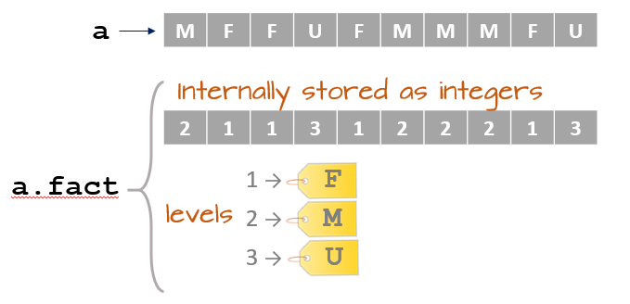
a is an object that is a vector, only contains one type of information. Either a word or a number.
a.fact is an object that is a factor, it contains multiple types of information for each variable
Factors have attributes where additional information is stored but hidden
Factors have attributes where additional information is stored but hidden.
Attributes can be labels, levels, values, and more ways of describing data in the data frame
https://mgimond.github.io/ES218/Week02a.html for an even more detail explanation with examples
Notes:
The vector, a, is a literally the letters “M”, “F”, and “U” stored as text. Can not do math with character data types.
When the vector is turned into a factor using the as.factor() command, the data type changes to an integer. Factors have multiple attributes which store information, but are hidden from the visible data frame. To view all the attributes of an object, use the attributes() command.
a.fact has two attributes: levels and class.
$levels stores the integer version, 1, 2, and 3 which is linked with the letters F, M, and U.
$class tells you that the object is a factor
https://mgimond.github.io/ES218/Week02a.html for an even more detail explanation with examples.

Slide 33
Open Datafile
Open file in R
Can use either File > Import > Select Data Type > Select Data File
Can type the command read_dta()
ANESdf <- read_dta("anes_timeseries_2016_Stata13.dta")
If the file is in your workspace
Otherwise, include the whole path to the file location, see below
ANESdf <-read_dta("C:\Users\username\Desktop\folder\PA402\anes_timeseries_2016_Stata13.dta")
Reads the .dta file and stores it as a new data frame in R, named ANESdf.
Name it something short but descriptive
Dataframe should now exist in the R Environment tab. Click it. What do you see?
Notes:
Mac users do not need the .dta extension at the end of the file name !!

Slide 34
Notes:
File > Import > From Stata> Browse for file you want
You can rename it in this interface too in the “Import Options” area. I did not do that in this image.

Slide 35
Making RStudio Work: Install Packages
install.packages(“packagename”) #installs on computer- only need to do this once
library(“packagename”) # loads the package into your workspace
install.packages(“tidyverse”) #contains dplyr, ggplot, tibble, readr, tidyr, purr
install.packages(“haven”) #can read SPSS and Stata files.
library(“tidyverse”)
library(“haven”)
Notes:
Fogarty pg 17

Slide 36
You can also use menus to important data files:
Can import multiple file types
.csv or .xlsx
.sas
.sav
Text
Or Open File → the file you want to use
Notes:
You can do this, but it doesn’t always work the way you want or only works for certain file types.

Slide 37
Types of Objects: Vectors, Matrices, and Data Frames
Vector = one-dimensional collection of data, can be a row OR column.
Data Frame = a type of matrix. Think of it like an excel file.
Matrix = combination of columns and rows. At least 1 of each.
Data sets are most often organized with variables in columns (ID number, age, evaluation of President’s performance, etc.) and unit of analysis (people, organizations, observations) in the rows.
Notes:
Vector = one-dimensional collection of data, can be a row OR column.
Matrix = combination of columns and rows. At least 1 of each.
Data Frame = a type of matrix. Think of it like an excel file.
Columns of a data frame are variables

Slide 38
Types of Data & Levels of Measurement
Nominal = logical (binary), factor (categorical)
No Order (ex. race, religion, etc.). Numbers assigned don’t have actual meaning
Ordinal = numeric
has general sense of increasing or decreasing order, but the distances between categories aren’t meaningful
Ex. 1 = high school diploma, 2 = undergraduate degree, 3 = masters degree
Number of years to get each one are all different
Not a form of measurement
Notes:
Discussed more in Week 3

Slide 39
Levels of Measurement: Interval vs. Ratio
Interval = numeric
Has order, Distance between numbers has meaning, 0 is arbitrary
Ex. Temperature in C or F, feeling thermometer survey questions
Ratio = numeric
Same as interval, but 0 implies an attribute does not exist
Ex. Movement of 0 mph, salary of $0,
Not a form of measurement
Notes:
Week 3

Slide 40
Factors, Levels, Values, and Labels
dataframe$variable <- factor(dataframe$variable, levels = 1:5 , labels = c( 'Excellent' , 'Very Good' , 'Good' , 'Fair' , 'Poor’ ))
# levels = the number of options for each variable
Like a multiple choice test (A, B, C, D or 1,2, 3, 4)
# labels = the word that is glued to the value or level of each option for a variable
Describes the variable, levels, or values
# values = numbers that would be used for calculations
# factors = kind of like a paperclip holding together the variable, levels, labels, and values

Slide 41
a is an object that is a vector, only contains one type of information. Either a word or a number.
a.fact is an object that is a factor, it contains multiple types of information for each variable
Factors have attributes where additional information is stored but hidden
Factors have attributes where additional information is stored but hidden.
Attributes can be labels, levels, values, and more ways of describing data in the data frame
https://mgimond.github.io/ES218/Week02a.html for an even more detail explanation with examples
Notes:
The vector, a, is a literally the letters “M”, “F”, and “U” stored as text. Can not do math with character data types.
When the vector is turned into a factor using the as.factor() command, the data type changes to an integer. Factors have multiple attributes which store information, but are hidden from the visible data frame. To view all the attributes of an object, use the attributes() command.
a.fact has two attributes: levels and class.
$levels stores the integer version, 1, 2, and 3 which is linked with the letters F, M, and U.
$class tells you that the object is a factor
https://mgimond.github.io/ES218/Week02a.html for an even more detail explanation with examples.

Slide 42
dplyr
Notes:
In last week’s lab, you learned to:
Open R, RStudio and data file.
Structure of R, Rstudio
Install packages.
This week, you will learn how to recode variables into new variables:
Recode missing values when needed.
Run frequencies of variables

Slide 43
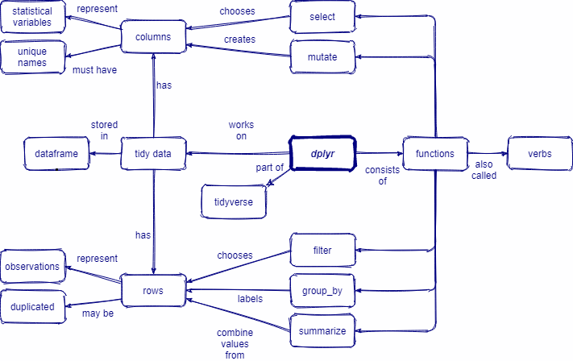

Slide 44
Slides below were originally done using $ coding. Remake with dplyr() code
Keep general ideas but redo.

Slide 45
Useful Functions and Packages
filter() to select cases based on their values.
arrange() to reorder the cases.
select() and rename() to select variables based on their names.
mutate() and transmute() to add new variables that are functions of existing variables.
summarize() to condense multiple values to a single value.

Slide 46
Create a Smaller Dataset: Subset Data
Notice there are 4270 variables in the ANES dataset
You probably don’t need them all.
Keep specific variables
> dataframenew <- subset(dataframeold, select = c(variable1, variable2, variable7:12)
Delete specific variables:
> dataframenew <- subset(dataframeold, select = - c(variable1, variable2, variable7:12)
# deletes variable1, variable2, and variable 7 through 12
Make our dataset smaller: ANES <- subset(ANES, select=-c(V161363a:V168528))
# deletes a bunch of variables/columns listed in the codebook that aren’t main variables
Notes:
Should have 570 variables left
Change to select () in tidyverse

Slide 47
Defining Missing Values = NA in R
Respondents who said “I don’t know” or refused to answer
Respondents who weren’t asked the question (e.g., men for questions about pregnancy)
Often, these responses are given numeric codes that separate them from the substantive values (-9, 99, etc.)
Avoid accidentally including them in analysis!
Numbers typically don’t have actual meaning
They will mess up your calculations unless you change them so that the program recognizes them as “missing” data

Slide 48
Recoding a Categorical Variable
#****gender*****
class(ANES$V161342)
table(ANES$V161342)
ANES$gender <- recode(ANES$V161342, "1='0.Male';2='1.Female'; else=NA")
attr(ANES$gender, "value") <- abs((1-as.numeric(ANES$gender))) #is numeric
table(ANES$gender)
attributes(ANES$gender)
Notes:
Categorical variable: You either are something or you are not something. Mathematical averages do not make sense. Frequently coded as dummy variables.

Slide 49
Descriptive Statistics in R
Notes:
In last week’s lab, you learned to:
Open R, RStudio and data file.
Structure of R, Rstudio
Install packages.
This week, you will learn how to recode variables into new variables:
Recode missing values when needed.
Run frequencies of variables

Slide 50
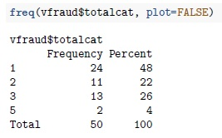
Frequency distributions and tables
Frequency distribution:
Tells us how many observations are at different values of a variable
Frequency table:
Summarizes a frequency distribution in an easy-to-understand presentation
In R:

Slide 51
Measures of central tendency
Measures of central tendency convey what the typical case looks like.
Mode:
Value of a variable that occurs most frequently
Median:
Middle value in a variable’s distribution, where an equal number of observations lie above and below (the 50th percentile)
Mean:
The average

Slide 52
Measures of dispersion
Measures of dispersion tell us the variability in our variables
Minimum/maximum (range)
Most useful for knowing the lowest and highest values of a variable
Variance
Tells us how observations are dispersed around the mean

Slide 53
Measures of dispersion
Standard deviation
Also, tells us how observations are dispersed around the mean
Preferred over variance b/c units of measurement make more sense
Is the square-root of the variance

Slide 54
Measures of central tendency and dispersion
Use both to get a more complete picture of a variable
Example:
In St. Louis, MO, USA, the mean percentage of black voters by voting precinct is 47% and the median is 42.5%. Sounds like a fairly mixed city?
But, the standard deviation is 37.5%; implying a very wide spread

Slide 55
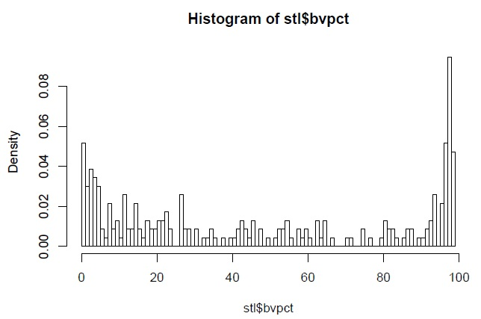
Measures of central tendency and dispersion
Just relying on the mean and median hides that St. Louis is very segregated

Slide 56
Levels of measurement and measures of central tendency and dispersion
Nominal-level variable: mode, min/max
Ordinal-level variable: mode, median, min/max
“High” ordinal-level variable (7+ categories): mode, median, mean, min/max, variance, standard deviation
Interval- or ratio-level variable: mode, median, mean, min/max, variance, standard deviation

Slide 57
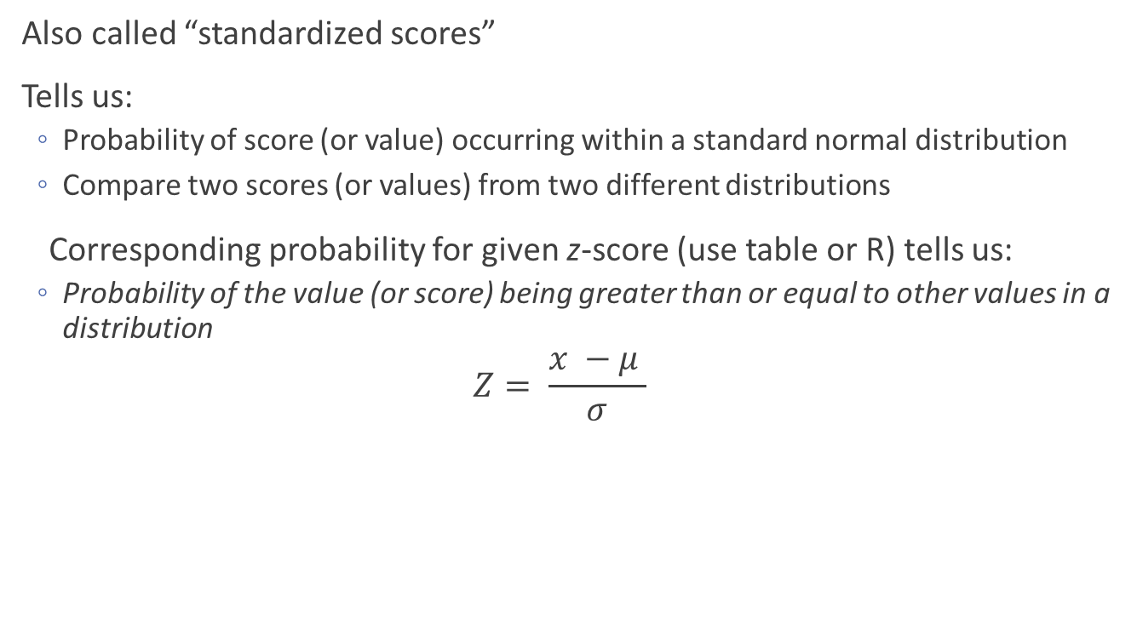
Z-scores
Also called “standardized scores”
Tells us:
Probability of score (or value) occurring within a standard normal distribution
Compare two scores (or values) from two different distributions
Corresponding probability for given z-score (use table or R) tells us:
Probability of the value (or score) being greater than or equal to other values in a distribution
$$Z= \frac{x −μ }{σ}$$

Slide 58
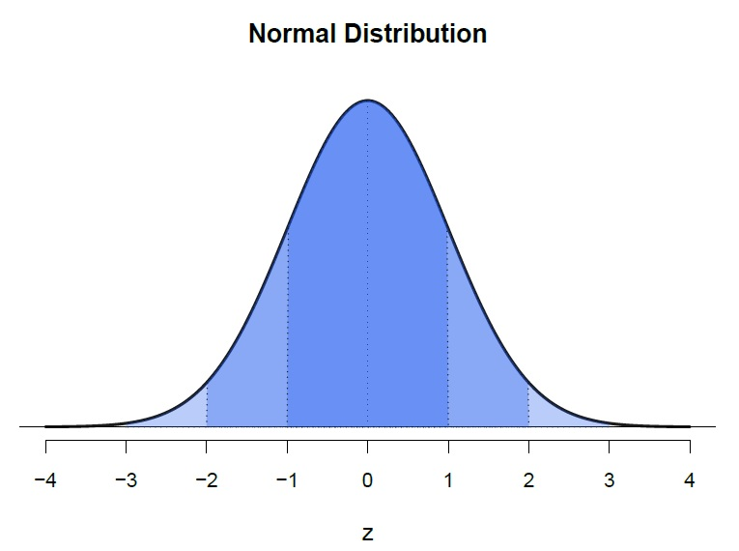
Z-scores and normal distribution

Slide 59
Example: Drinky time squirrel
Beer drinking
Z-score for beer drinking is 2.50.
Corresponds to a probability of .994.
Interpreted as:
Drinky time squirrel drinks more or the same number of pints per week as 99.4% of the Glasgow squirrel population

Slide 60
Example: Drinky time squirrel
Whisky drinking:
Z-score for whisky drinking is 2.00.
Corresponds to a probability of .977.
Interpreted as:
Drinky Time Squirrel drinks more or the same number of whiskys per week as 97.7% of the Glasgow squirrel population

Slide 61
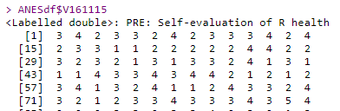
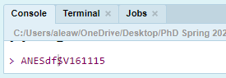
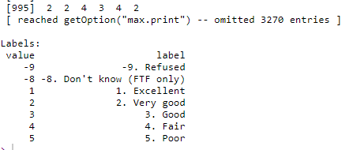
Look at a Variable: V161115
> ANESdf$V161115 #type in Console
Get output for that variable.
Shows first 1000 observations and information on labels.
Tells R which dataset to use
Tells R which variable you want
Notes:
Unlike other statistics programs, R can use multiple datasets in one analysis. However you need to tell it which dataset to use when you are working with variables. When referencing a variable, you must use the format of dataframe$variable so that R knows what you want. This is another reason to label your variable with short, but useful names.

Slide 62
Each time R is opened, a new “Session” starts
The file viewer. Here you can write your code in a script file for safekeeping and reuse or look at your data in spreadsheet format. When you want to look at more than one file at a time, you can view them in a separate window.
The console. This is where you enter code and see the output. You can either type out your code here or highlight code in the file viewer and use a keyboard shortcut to have it automatically entered.
The environment viewer. This shows you a list of all the objects that are currently in R’s environment. Data frames, objects, factors, anything you create or import
Files/Plots/Packages/Help. Does a wide range of things and it is customizable.

Slide 63
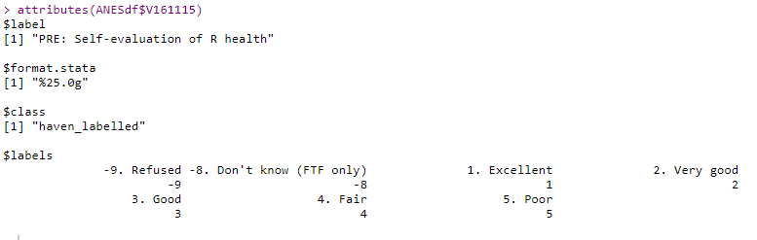
Attributes: V161115
# type in Console or project file
> attributes(ANESdf$V161115)
$label = label of the question. “Pre” means the question was asked before the election.
$class = haven was the program used to read in the data. Creates a temporary class that allows you to turn it into a more useful “factor.” Normally would want it to say “factor” or “numeric” for an analysis
$labels = description of the variable. Combined information from datafile for numeric values and text descriptions
Notes:
Has attributes: $value (with just numbers), $label (character data type that describes what the question was), $class (tells you how information is bundled together for the variable and what you can do with the variable)

Slide 64
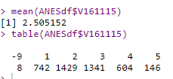
Frequencies: V161115
> table(ANESdf$V161115)
Shows frequency of observations for each coded option
742 selected the option that was coded 1
8 people were coded as -9.
> mean(ANESdf$V161115)
R sometimes knows to use the numeric part of the label
There are better ways of data management
Is this useful? Does it tell you anything?
Only if you look at the Codebook!
Top row is potential responses coded as an integer.
Bottom row is number of people who selected each potential response.
Notes:
Unlike other statistics programs, R can use multiple datasets in one analysis. However you need to tell it which dataset to use when you are working with variables. When referencing a variable, you must use the format of dataframe$variable so that R knows what you want. This is another reason to label your variable with short, but useful names.
Has attributes: value (with just numbers), label ()

Slide 65
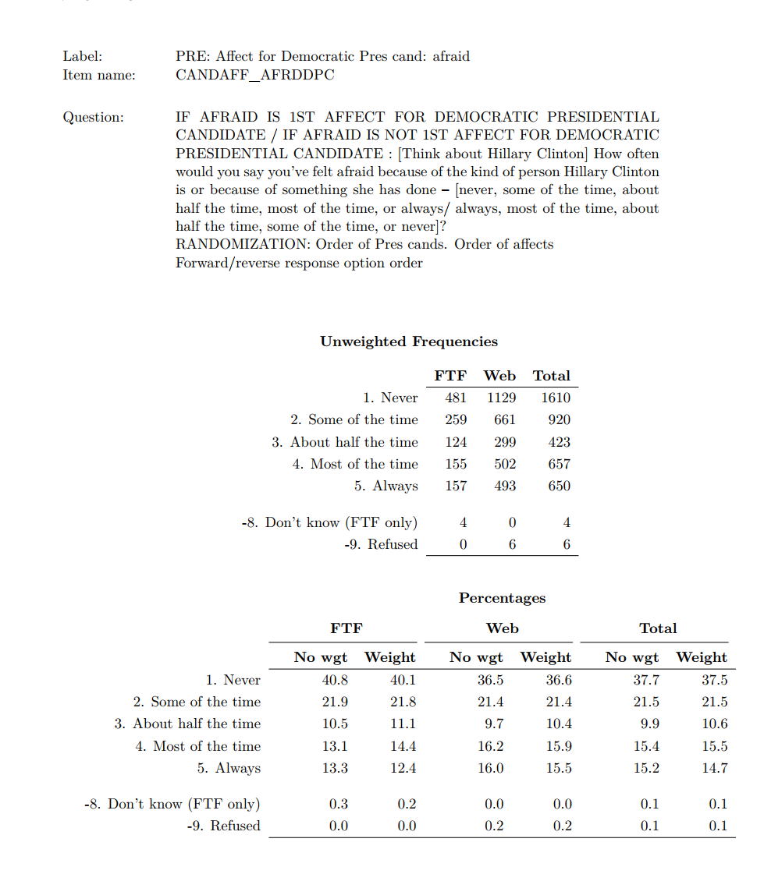
Example from a codebook:
In this case, you would want to recode -8 and -9 as missing values
When you import a file (depending on the file type), it prompts you with an NA blank box
You can enter the values that you want to become “missing” for entire dataset
This is not always an option
Messy data, different file types, etc.
Can also do with code commands
Notes:
There are a lot of ways to deal with missing values. If in doubt, Google it out.

Slide 66
Which responses are coded as missing for V161115?
How else can you figure out if there are missing values for different variables?
THE CODEBOOK! --> V161115 says that -9 is for “Refused” aka Missing
Scroll through the data.frame in the Viewer
Click on View> Show Viewer if it isn’t already open
Do you see 0’s, negative numbers, weirdly large numbers, or NA’s?
If you see NA’s, that is good!
If you see 99, -9, -8, etc., these need to be coded as missing
Notes:
Lets say you don’t have perfectly cleaned data designed to be used in R and you need to know if R recognizes that there is data coded as missing.
V161115 has -9 for refused answers.

Slide 67
Reverse Coding and Change Scale
Reverse direction to be more sensible, “lowest” value = 0
Want:
Poor = 0
Fair = 1
Good = 2
Very Good = 3
Excellent = 4
Absolute value of (1 – variable options)
|1-5| = 4 = Excellent
|1-4| = 3
|1-3| = 2
|1-2| = 1
|1-1| = 0 = Poor
Reversed direction and change scale to range from 0 to 1
Poor = 0/4 = 0
Fair = 1/4 = .25
Good = 2/4 = .50
Very Good = 3/4 = .75
Excellent = 4/4 = 1
R code would be:
usefulVariable <- abs((1-numericVariable)/4)
Notes:
Healthy <- (5-V161115)/5
You can use recode() directly with factors; it will preserve the existing order of levels while changing the values.

Slide 68
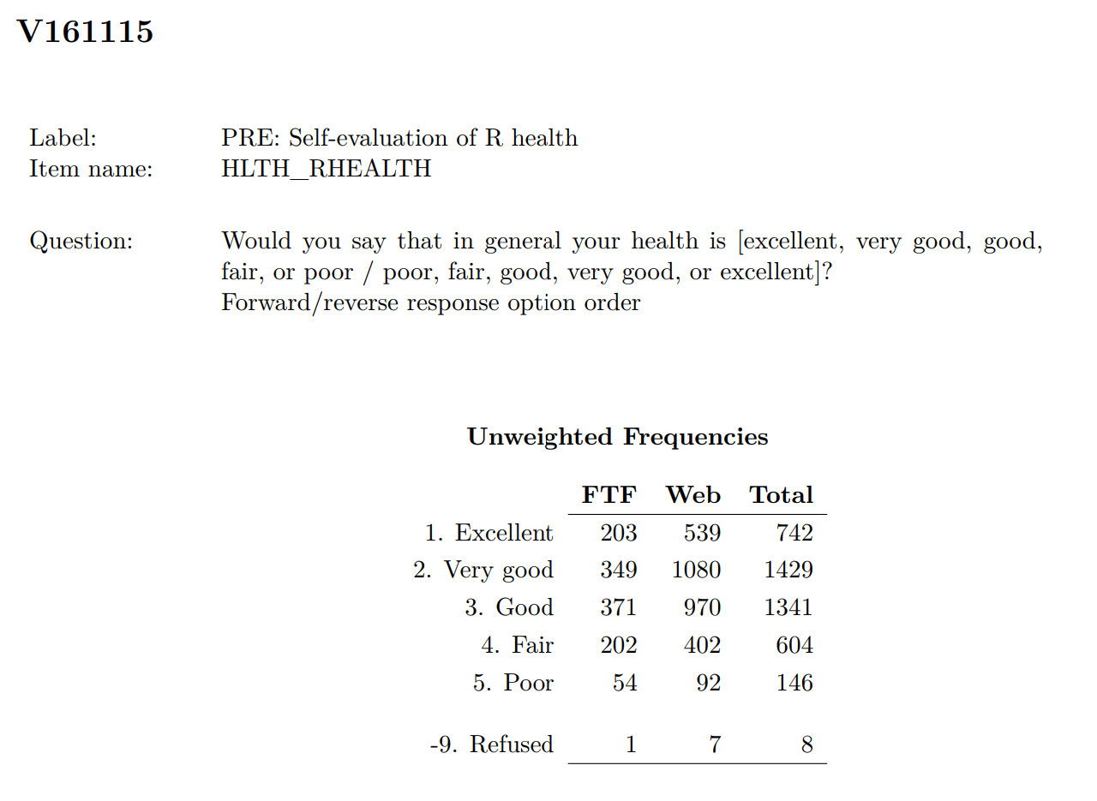
What’s the problem with this coding?
It has “refused” coded as -9
-9 → NA
Responses are 1- 5
Want 0-1 for analysis
Want scores to be from “low” to “high”
Flip order of responses
Should end up with a scale of Poor (0) to Excellent (1)
Notes:
It has “refused” coded as -9
-9 → NA
Responses are 1- 5
Want 0-1 for analysis
Want scores to be from “low” to “high”
Flip order of responses
Should end up with a scale of Poor (0) to Excellent (1)

Slide 69
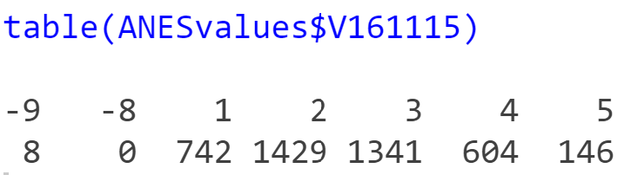
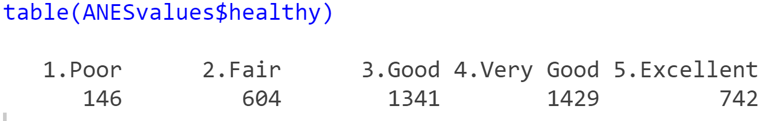
Fixing V161115: Aesthetics
# Run variable frequency
> table(ANESvalues$V161115)
#without labels
> ANESvalues$healthy <- recode(ANESvalues$V161115, "5='1.Poor';4='2.Fair';3='3.Good';2='4.Very Good';1='5.Excellent';else=NA")
#recode from low to high
# -8 and -9 recoded as NA

Slide 70
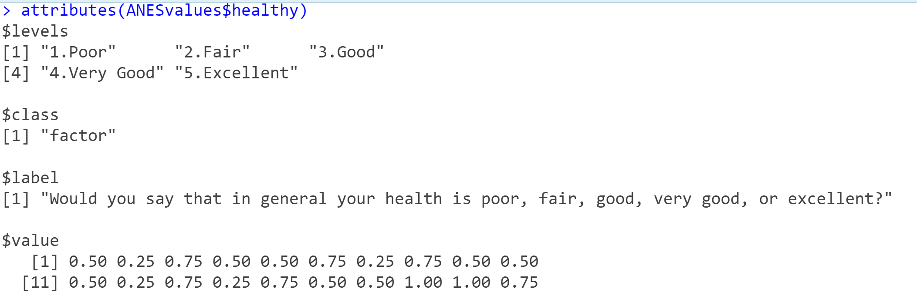
Fixing V161115: New Scale
> attr(ANESvalues$healthy, "value") <- abs((1-as.numeric(ANESvalues$healthy))/4)
# is numeric; allows mathematical calculations.
# Now it is on scale from 0 to 1 for analysis
Notes:
Usage
na_if(x, y)
Arguments
X Vector to modify
Y Value to replace with NA

Slide 71
Creating Indices
Measurement, Types of Variables, Indices, and Reliability
Notes:
In last week’s lab, you learned to:
Open R, RStudio and data file.
Structure of R, Rstudio
Install packages.
Recode missing values when needed.
Run frequencies of variables
This week, you will learn to
Creat a multi-item scale
Recode them to the same scale
Test alpha coefficient
Combine into an index
Validity
Reliability

Slide 72
Example Index in R: Racial Resentment (ANES 2016)
V152211: Irish, Italians, Jewish and many other minorities overcame prejudice and worked their way up. Blacks should do the same without any special favors.
V162212: Generations of slavery and discrimination have created conditions that make it difficult for blacks to work their way out of the lower class.
V162213: Over the past few years, blacks have gotten less than they deserve.
V162214: It’s really a matter of some people not trying hard enough, if blacks would only try harder they could be just as well off as whites.
All are Likert scales that go from Agree Strongly → Disagree Strongly
BUT do they actually capture positive or negative sentiment?

Slide 73
Scales: Direction Matters!
V162211: Irish, Italians, Jewish and many other minorities overcame prejudice and worked their way up. Blacks should do the same without any special favors.
Strongly Agree = most racist
V162212: Generations of slavery and discrimination have created conditions that make it difficult for blacks to work their way out of the lower class.
Strongly Agree = least racist
V162213: Over the past few years, blacks have gotten less than they deserve.
Strongly agree = least racist
V162214: It’s really a matter of some people not trying hard enough, if blacks would only try harder they could be just as well off as whites.
Strongly Agree = most racist
If you were to combine the observations as they are coded, what would happen?
Notes:
Answer, you’d get a mathematical answer, but any interpretation would not be valid because you have two variables going from least racist -> most racist and two variables going from most racist -> least racist.
V162211 and V162214 need to be flipped in order to make an index of racial resentment!

Slide 74
Reverse Recoding
If you were trying to capture racial resentment with these variables, they must be coded so that the underlying construct is measured in the same direction.
Either flip direction of V162211 & V162214 OR flip V162212 & V162213.
Depending on which variables are recoded, the construct of racial resentment goes from:
most racist → least racist
OR
least racist → most racist.
JUST BE CONSISTENT AND KNOW WHICH DIRECTION YOU CHOSE!

Slide 75
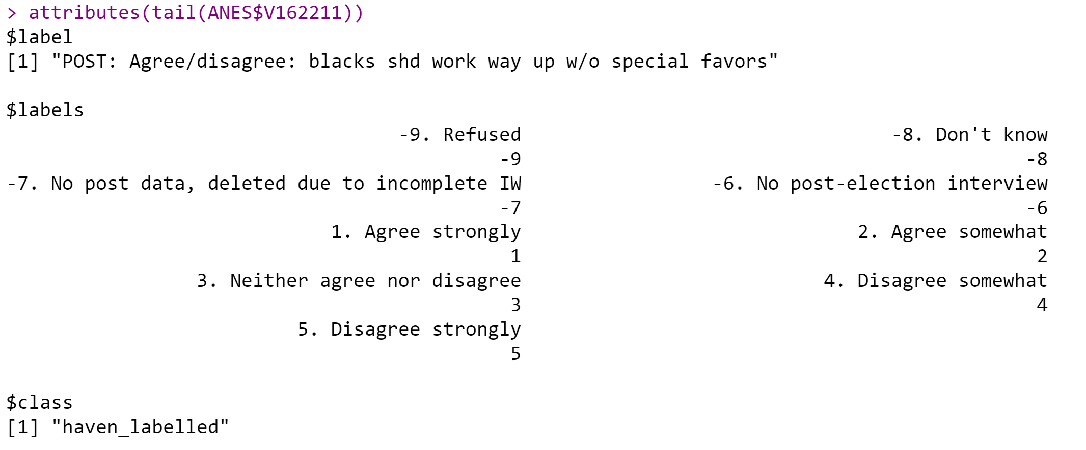
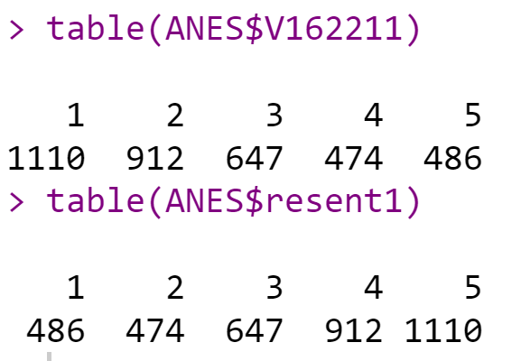
V162211: Irish, Italians, Jewish and many other minorities overcame prejudice and worked their way up. Blacks should do the same without any special favors. => Strongly Agree = most racist
> ANES$resent1 <- recode(ANES$V162211, "5=1; 4=2;3=3;2=4;1=5")
R has already taken care of the missing values – they don’t show up in the table
Make sure values match! Originally, “1. Agree Strongly” had 1110 people select it. It has to match the 5th level that represents higher levels of racial resentment. Check other levels too!
Notes:
# Don't need to label everything when making an index
# You do need to know the direction of coding and its meaning for each variable. Some go high->low, some go low-> high.
### **** Racial Resentment Correlation and Index Creation **** ###
table(ANES$V162211)
# You do need to know the direction of coding and its meaning for each variable. Some go high->low, some go low-> high.
ANES$resent1 <- recode(as.numeric(ANES$V162211), "5=1; 4=2;3=3;2=4;1=5")
#Think of the format this way: What you have = what you want.
table(ANES$resent1)
table(ANES$V162212)
ANES$resent2 <- ANES$V162212
ANES$resent3 <- ANES$V162213
ANES$resent4 <- recode(as.numeric(ANES$V162214),"5=1; 4=2;3=3;2=4;1=5")
table(ANES$resent4)

Slide 76
Another way to recode ANES$resent1 that has labels
# Still format of "Have=Want“ when recoding variables
> table(ANES$V162211)
> ANES$resent1OPTION2 <- recode(as.numeric(ANES$V162211), "1='5.Strongly Disagree';2='4.Disagree';3='3.Neither Agree/Disagree';4='2.Agree';5='1.Strongly Agree’”)
> table(ANES$resent1OPTION2)

Slide 77
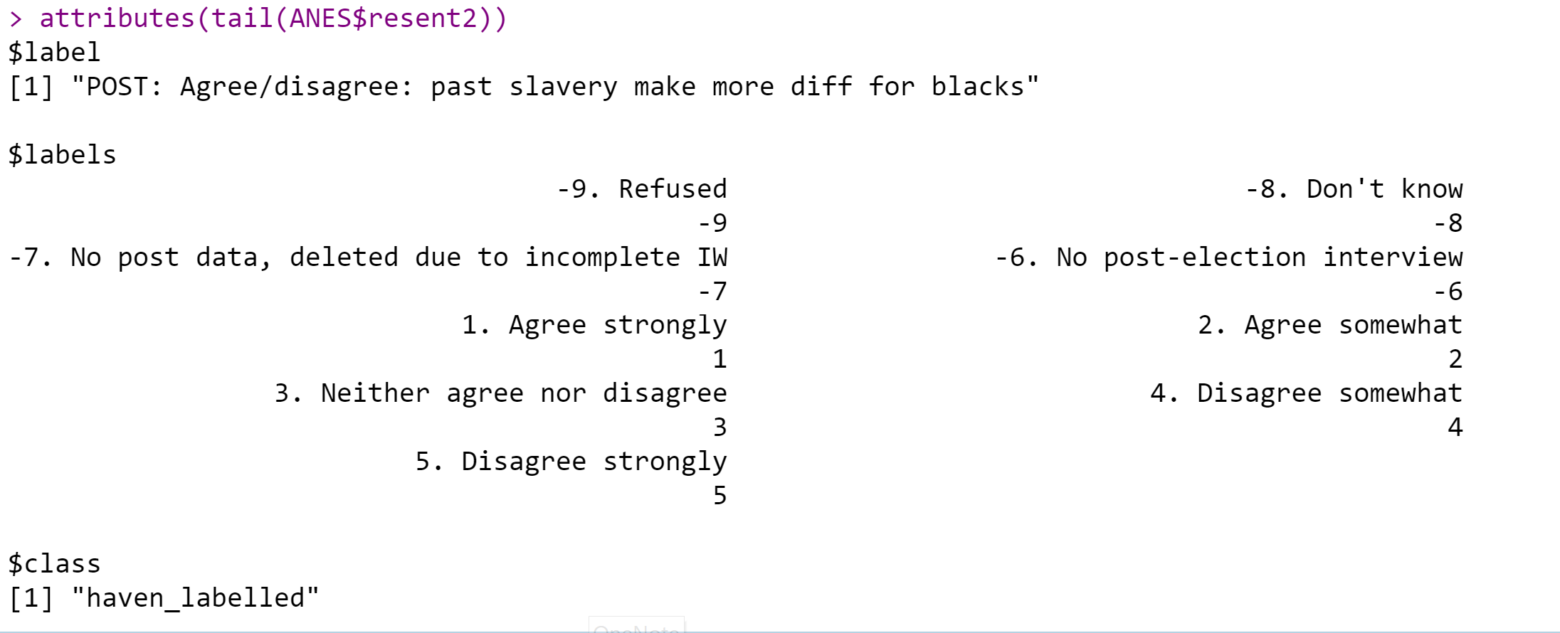
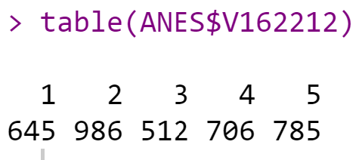
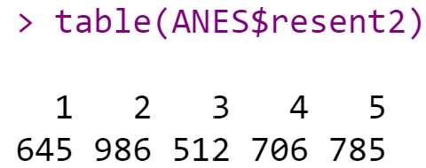
V162212: Generations of slavery and discrimination have created conditions that make it difficult for blacks to work their way out of the lower class. => Strongly Agree = least racist
> table(ANES$V162212)
# Note that missing values are taken care of already in table()
> ANES$resent2 <- ANES$V162212
# yes, it is that easy
> table(ANES$resent2)
Make sure values match! Originally, “1. Agree Strongly” had 645 people select it. We didn’t reverse this one, so it is correct.
Notes:
table(ANES$V162212)
# Note that missing values are taken care of already in table()
ANES$resent2 <- ANES$V162212
# yes, it is that easy.
table(ANES$resent2)

Slide 78
Example Index: Racial Resentment Variables
# Look at codebook to determine direction of scales for underlying construct
# Don't need to label everything when making an index
ANES$resent1 <- recode(as.numeric(ANES$V162211), "5=1; 4=2;3=3;2=4;1=5")
ANES$resent2 <- ANES$V162212
ANES$resent3 <- ANES$V162213
ANES$resent4 <- recode(as.numeric(ANES$V162214),"5=1; 4=2;3=3;2=4;1=5")
# check your work to make sure the counts still match those of the codebook.
Notes:
More than one way to label things!

Slide 79
Cronbach alpha reliability test
Cronbach’s alpha is a measure of internal consistency and scale reliability.
Higher values show better scale reliability.
Usually, α > .70 is acceptable.
Before using an index for racial resentment, check the correlation between the variables in the index
> library(psych)
> someindex <- subset(dataframe, select=c(rangeOf:variablesYouWant)) # creates index / mini df
> alpha(someindex) # estimate of reliability for a single scale

Slide 80
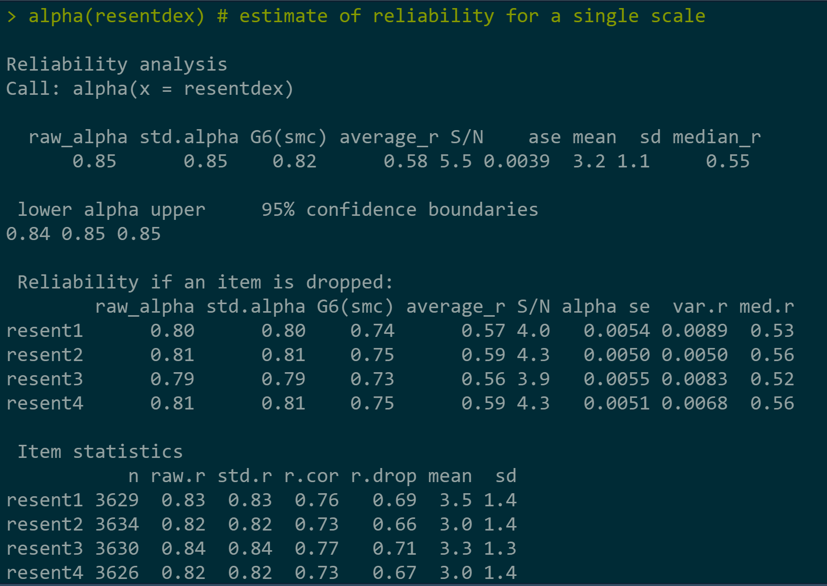
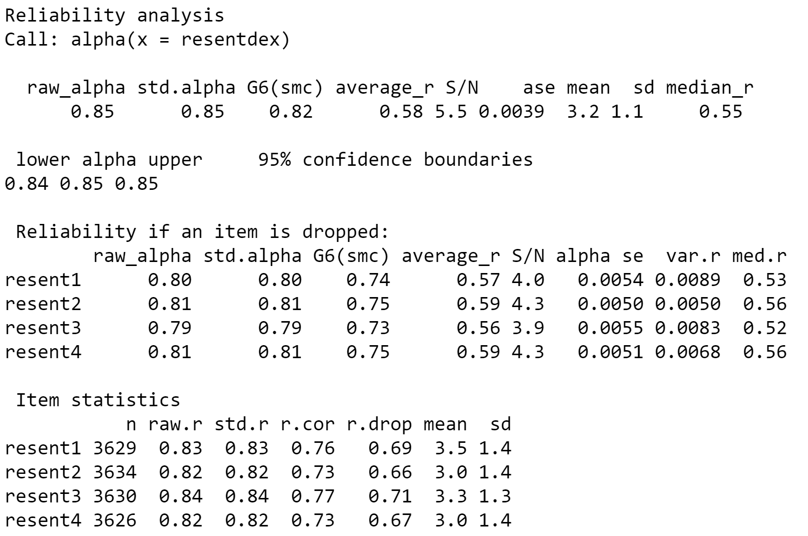
Raw_alpha is what we care about
None of the alphas increase when a variable is dropped. Therefore keep the variables.
Notes:
What do the summary statistics mean?
raw_alpha: Cronbach’s α (values ≥ .7 or .8 indicate good reliability; Kline (1999))
std.alpha: this should be similar to raw_alpha (we only need the raw alpha though)
G6: Guttman’s lambda 6 (calculated from the squared multiple correlation or ‘smc’)
average_r: average inter-item correlation (this is used to calculate std.alpha)
mean: scale mean (the mean of the means of all individuals)
sd: scale sd
How to interpret ‘Reliability if an item is dropped’?
The overall α (raw_alpha) is .85. Each row refers to each item and has a raw alpha associated—this refers to the overall α when that particular item has been dropped/deleted. For example, the first row refers to resent1, and if it is dropped, the overall α becomes .80, which reflects worse reliability, so we want to keep resent1.
We are checking whether any of these raw alpha values are greater than the overall α of .85; if yes, this means that dropping that particular item will increase the overall α of the scale.
The other columns of this table refer to how the other statistics will change if that particular item has been dropped/deleted.
How to interpret ‘Item statistics’?
raw.r: correlation between the item and the total score from the scale (i.e., item-total correlations); there is a problem with raw.r:, the item itself is included in the total—this means we’re correlating the item with itself, so of course it will correlate (r.cor and r.drop solve this problem)
r.drop: item-total correlation without that item itself (i.e., item-rest correlation or corrected item-total correlation); low item-total correlations indicate that that item doesn’t correlate well with the scale overall
r.cor: item-total correlation corrected for item overlap and scale reliability
mean and sd: mean and sd of the scale if that item is dropped
All items should correlate with the total score, so we’re looking for items that don’t correlate with the overall score from the scale. If r.drop values are less than about .3, it means that particular item doesn’t correlate very well with the scale overall.
How to interpret the final frequency table?
This table tells us what percentage of people gave each response to each of the items (i.e., if you have a 5-point scale, then it tells you how many percent of responses were 1, 2, 3, 4, or 5).
This helps you check the distribution of responses and whether everyone is giving the same responses (which will lead to low reliability).

Slide 81
Options if alpha coefficient is small:
1. Drop item(s) if that improves alpha to acceptable levels.
2. Look for other items to include in index to improve.
3. Consider as separate measures (not of the same underlying construct).
4. Combine them into an index and report it, even if it less than 0.7.

Slide 82
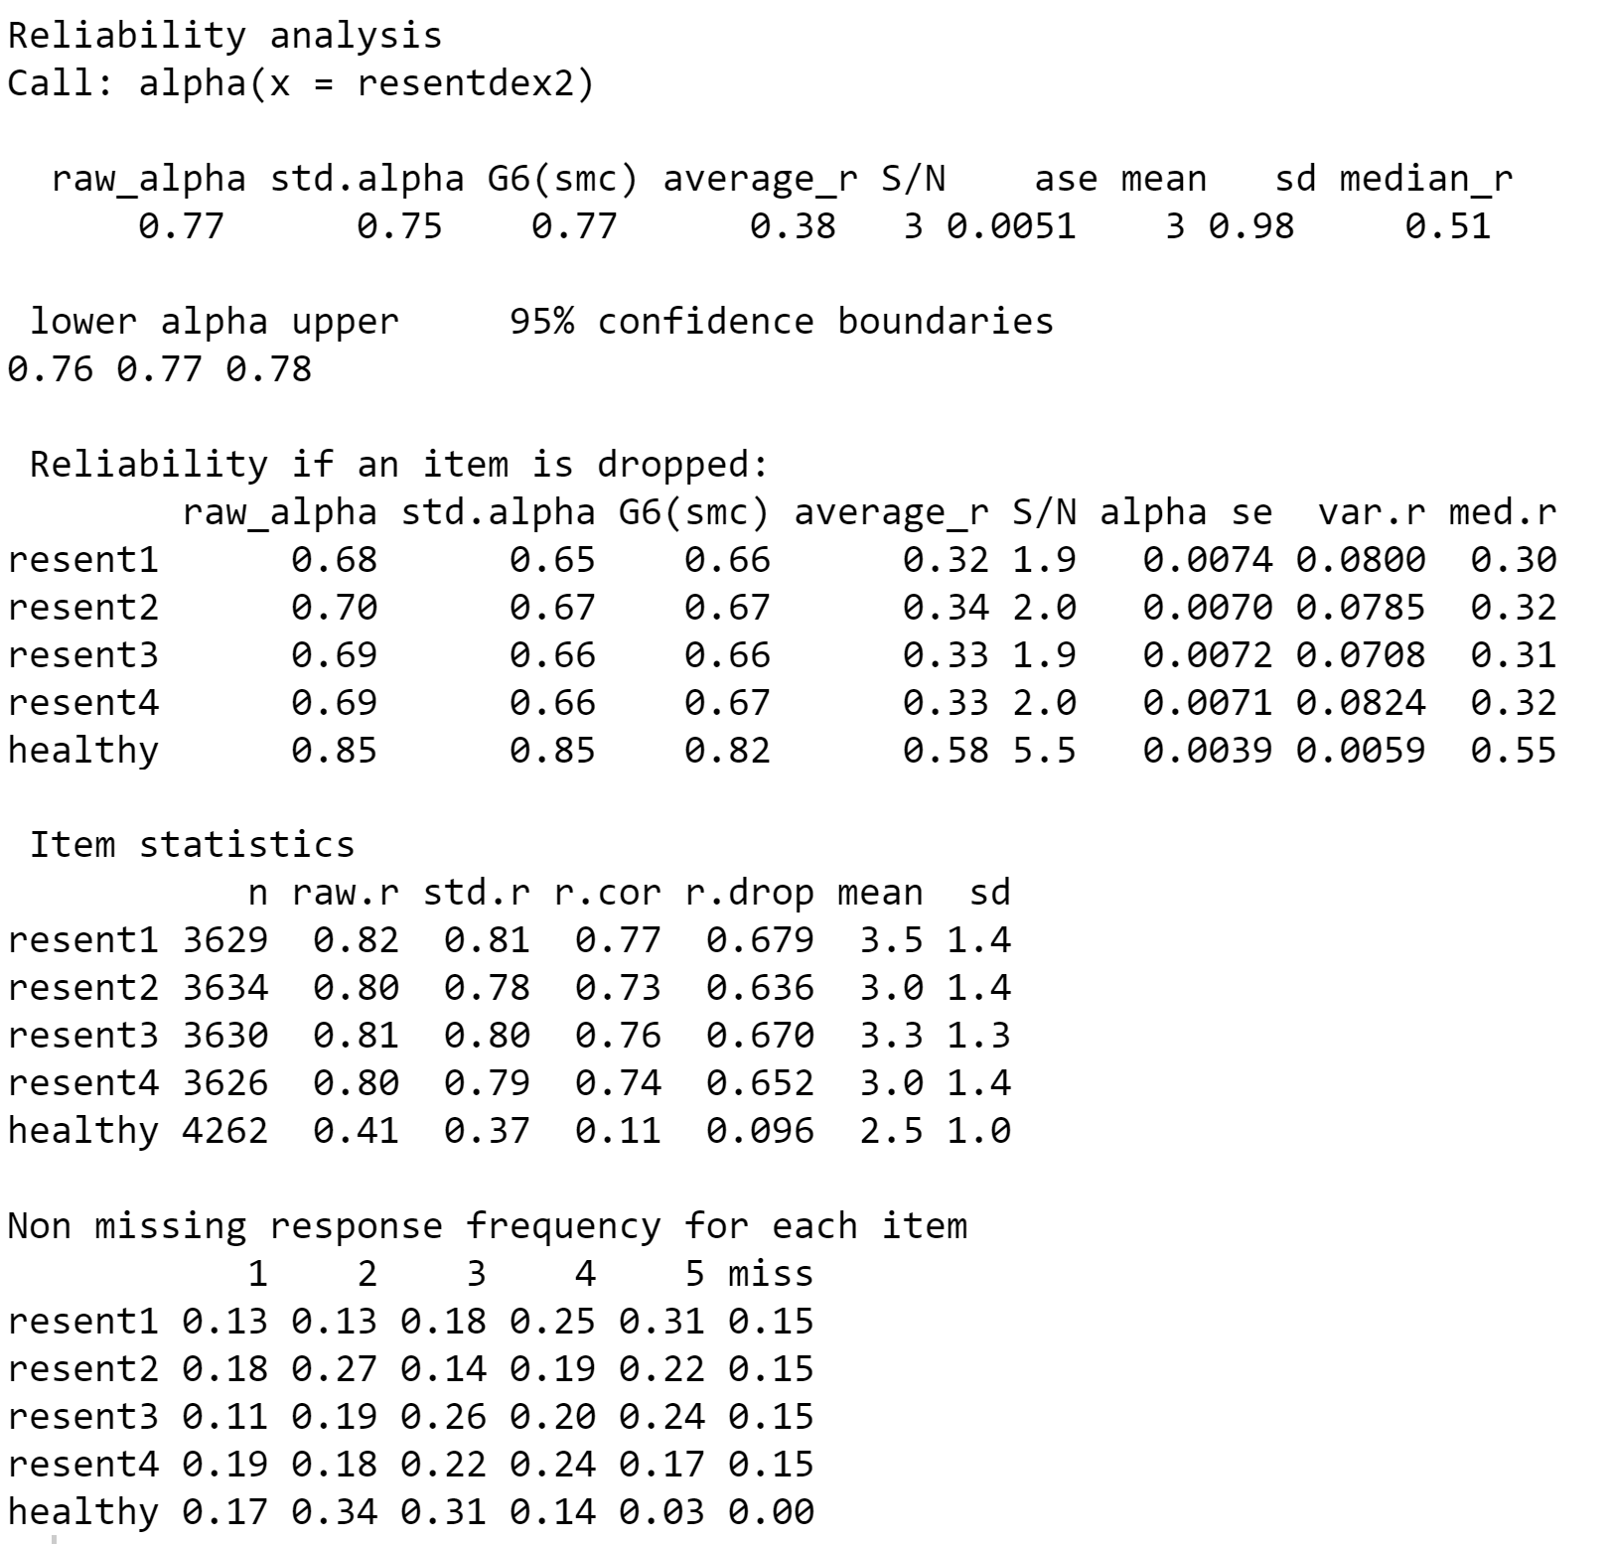
Raw alpha is what we care about
> resentment2 <- subset(ANES, select=c(resent1, resent2, resent3, resent4, healthy))
If the “healthy” variable is dropped, the alpha coefficient increases to 0.85.
This implies that “healthy” doesn’t measure the same construct as the other variables.
Notes:
Slide shows what happens if a variable that doesn’t fit into the construct is added into the index. Perceptions of health do not logically tap into the same construct as racist beliefs.
How to interpret ‘Reliability if an item is dropped’?
The overall α (raw_alpha) is .77 for the “resent” variables with the healthy variable. Each row refers to each item and has a raw alpha associated—this refers to the overall α when that particular item has been dropped/deleted. For example, the first row refers to resent1, and if it is dropped, the overall α becomes .68, which reflects worse reliability, so we want to keep resent1.
We are checking whether any of these raw alpha values are greater than the overall α of .77; if yes, this means that dropping that particular item will increase the overall α of the scale.
The other columns of this table refer to how the other statistics will change if that particular item has been dropped/deleted.

Slide 83
Lab Activity: Government Trust
We want to create an index to measure the level of trust in government How would you recode each of those so that higher numbers indicated greater trust?
Use V161215, V161217, V161218, V161219
2. Use alpha reliability coefficient approach to test whether those items can be combined into an index. Does dropping any of the items improve the alpha coefficient?
3. Create an index using the variables.
Notes:
Think about why it is possible to still have a low construct validity even if you find a large alpha coefficient.
Hint to find variables quickly in codebook:
CTRL+F for variable name

Slide 84
Government Trust Index
V161215: How often can you trust the federal government in Washington to do what is right?
V161217: Do you think that people in government waste a lot of the money we pay in taxes, waste some of it, or don’t waste very much of it?
V161218: How many of the people running the government are corrupt?
V161219: Generally speaking, how often can you trust other people?
Notes:
Low Levels of Trust -> High levels of trust.
Do any variables need to be reverse coded?

Slide 85
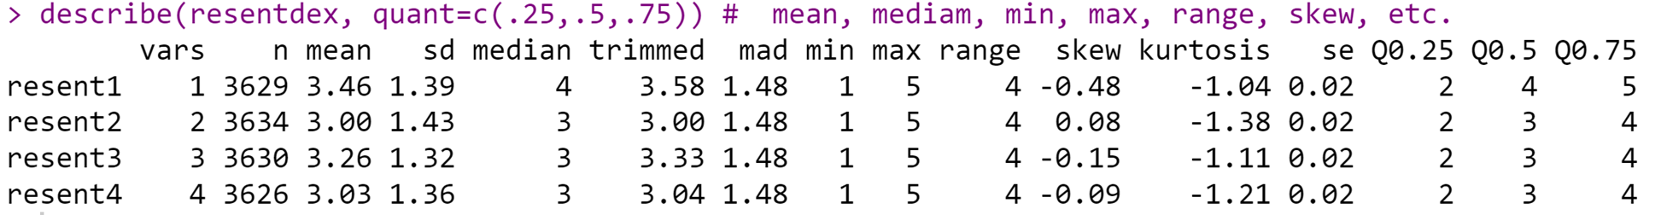
How to obtain descriptive statistics
describe() reports means, standard deviations, medians, min, max, range, skew, kurtosis and standard errors for integer or real data.
Non-numeric data, although the statistics are meaningless, will be treated as if numeric (based upon the categorical coding of the data)
Just because you can do math with the data, doesn’t mean you should
Notes:
x
A data frame or matrix
na.rm
The default is to delete missing data. na.rm=FALSE will delete the case.
interp
Should the median be standard or interpolated
skew
Should the skew and kurtosis be calculated?
ranges
Should the range be calculated?
trim
trim=.1 – trim means by dropping the top and bottom trim fraction
type
Which estimate of skew and kurtosis should be used? (See details.)
check
Should we check for non-numeric variables? Slower but helpful.
fast
if TRUE, will do n, means, sds, min, max, ranges for an improvement in speed. If NULL, will switch to fast mode for large (ncol * nrow > 10^7) problems, otherwise defaults to fast = FALSE
quant
if not NULL, will find the specified quantiles (e.g. quant=c(.25,.75) will find the 25th and 75th percentiles)
IQR
If TRUE, show the interquartile range
omit
Do not convert non-numerical variables to numeric, omit them instead
head
show the first 1:head cases for each variable in describeData
tail
Show the last nobs-tail cases for each variable in describeData

Slide 86
Recoding Variables
Create dichotomous variables, ordinal variables, groups

Slide 87
Create a Binary Variable from Categorical
We want to create a binary variable that equals 1 if the respondent believes women should never be able to obtain an abortion, and 0 otherwise (coding categories 5, -8, and -9 as NA).
> attributes(tail(ANES$V161232))
$label
[1] "PRE: STD Abortion: self-placement"
$labels
-9. Refused
-8. Don't know (FTF only)
1. By law, abortion should never be permitted.
2. By law, only in case of rape, incest, or woman's life in danger.
3. By law, for reasons other than rape, incest, or woman's life in danger if need established
4. By law, abortion as a matter of personal choice.
5. Other SPECIFY
$class
[1] "haven_labelled"

Slide 88
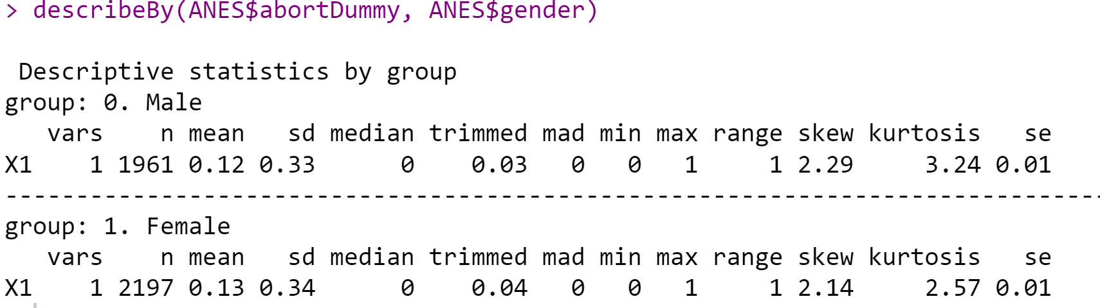
Create a Binary Variable from Categorical
attributes(tail(ANES$V161232))
table(ANES$V161232)
ANES$abortDummy <- recode(ANES$V161232, "1=1; 2=0;3=0;4=0; else=NA")
table(ANES$abortDummy)
describeBy(ANES$abortDummy, ANES$gender)

Slide 89
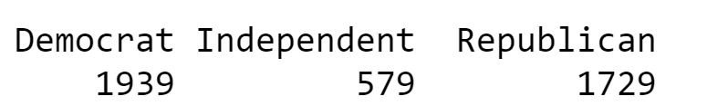
Consolidating a Variable’s Categories
ANES$partyid <- ANES$V161158x
ANES$partyid3 <- plyr::mapvalues(ANES$partyid, c(1,2,3,4,5,6,7), c('Democrat', 'Democrat', 'Democrat', 'Independent', 'Republican', 'Republican', 'Republican'))
table(ANES$partyid3)
table(ANES$V161158x)
0. DK; NA; other; refused to answer 968
1. Strong Democrat 9320
2. Weak Democrat 10390
3. Independent - Democrat 5649
4. Independent - Independent 5617
5. Independent - Republican 4772
6. Weak Republican 6790
7. Strong Republican 5592
Notes:
Always create a new variable – do not overwrite old variables (lost data – in your case backup on BB, but not always true).
Will create a new column in your data file – data view (and new row in variable view).
Always keep syntax so you know how you created new variables.

Slide 90
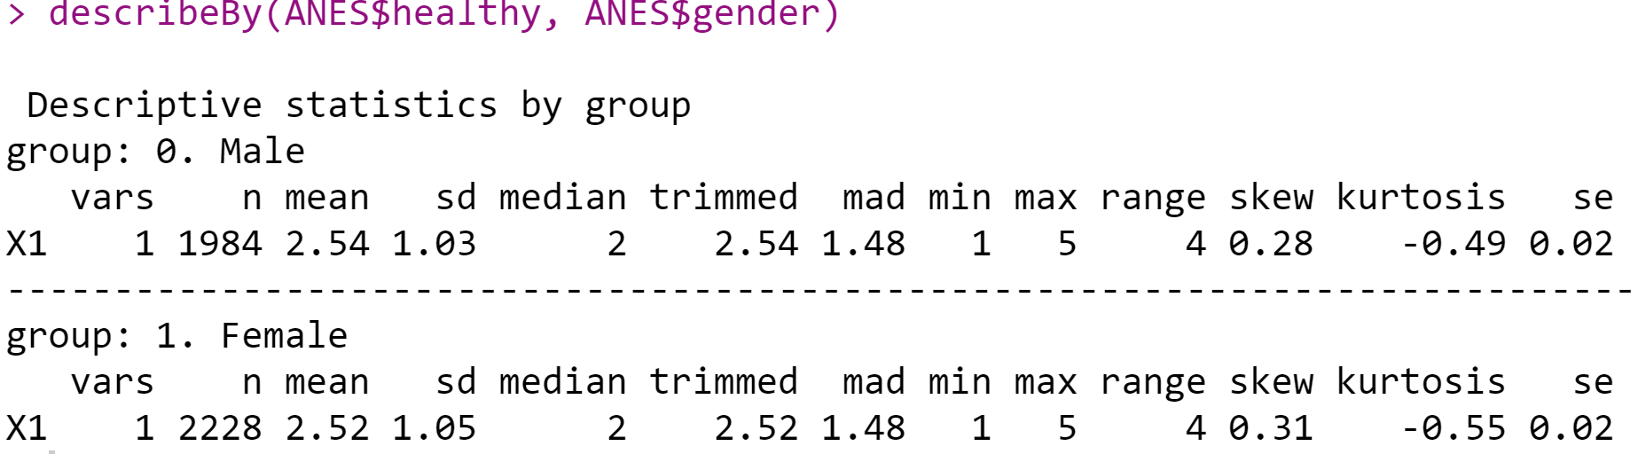
Comparing Groups so far….
describeBy reports descriptive statistics broken down by some categorizing variable (e.g., gender, age, etc.)

Slide 91
Comparing Groups so far….
> table(ANES$healthy, ANES$partyid3)
#Crosstabs of perception of health by party identification
> crosstabs <- xtabs(~healthy+partyid3, data=ANES) #useful for multiple variables
> summary(crosstabs)
partyid3
healthy Dem. Ind. Rep.
1 353 86 302
2 625 164 638
3 606 203 521
4 285 95 220
5 66 30 48
Notes:
Pg 174

Slide 92
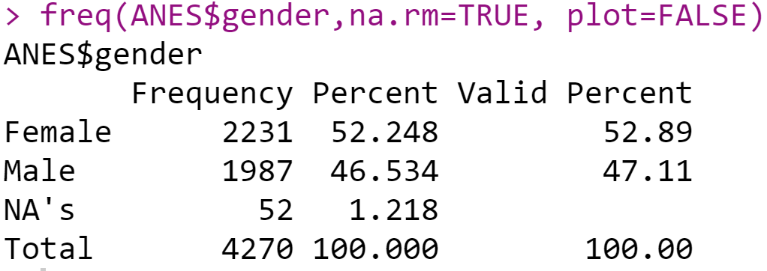
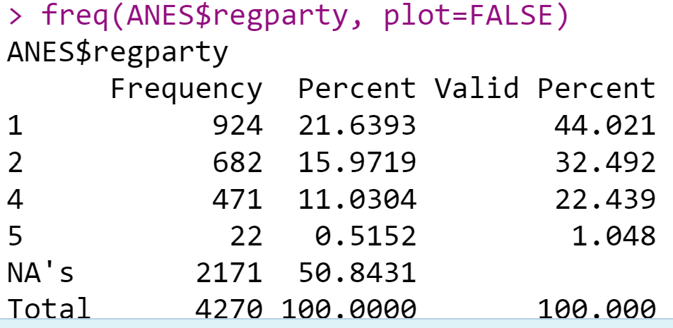
Frequencies with percentages
> freq(ANES$gender, na.rm=TRUE, plot=FALSE)
# women make up 52.25% of the respondents surveyed
Notes:
Pg 174

Slide 93


Quantitative Social Science Data with R: An Introduction
Brian Fogarty

Slide 94
Chapter 8
Visualizing data

Slide 95
Scope
Bar plots
Histograms
Boxplots
Scatterplots

Slide 96
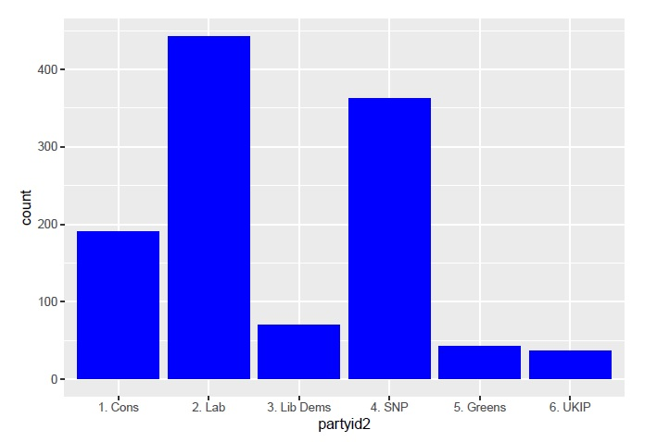
Bar plots
Use them with nominal- or ordinal-level variables; when we do not have continuous variables

Slide 97
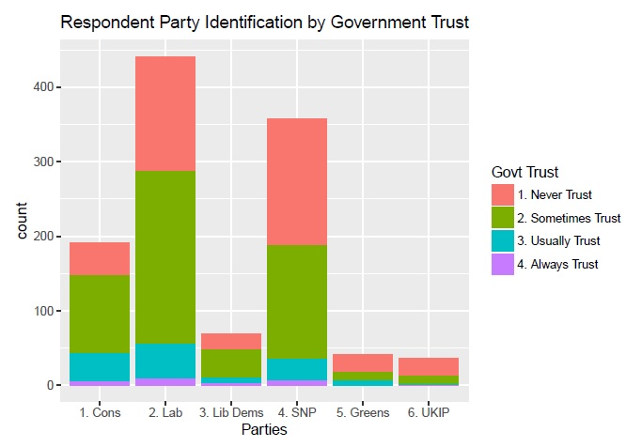
Bar plots
Can include a second variable

Slide 98
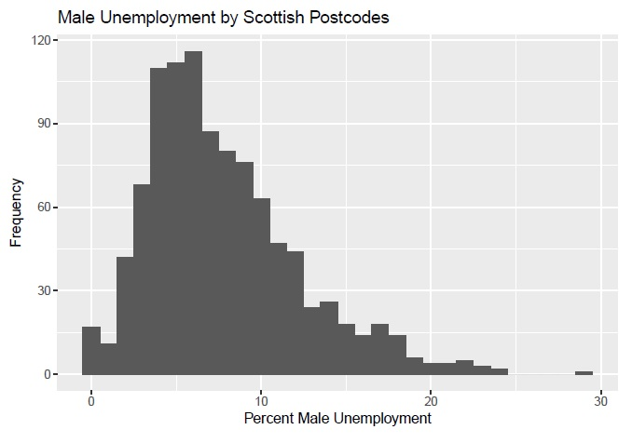
Histograms
Use them with interval- or ratio-level variables
Binwidth matters

Slide 99
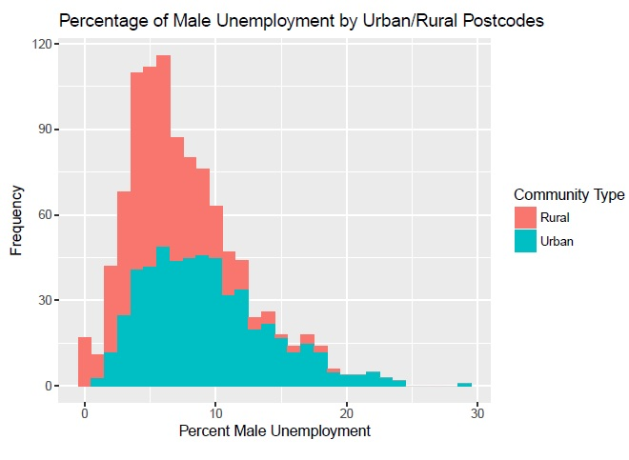
Histograms
Often we also include a categorical variable

Slide 100
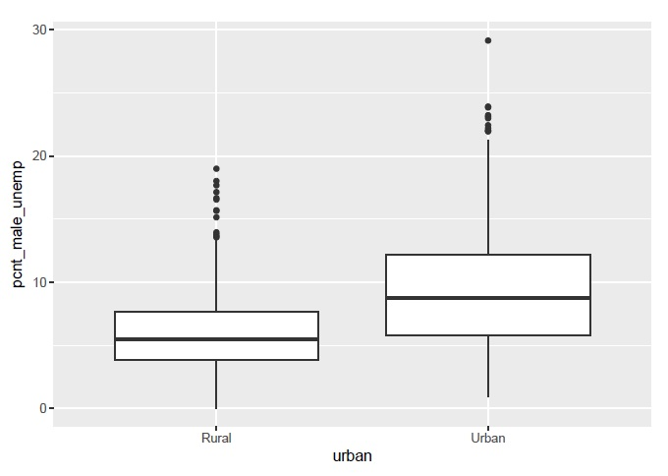
Boxplots
Simple way to visualize relationship between a continuous variable and categorical variable
Provides 5 summary statistics: min, max, median, 25% and 75% quartiles

Slide 101
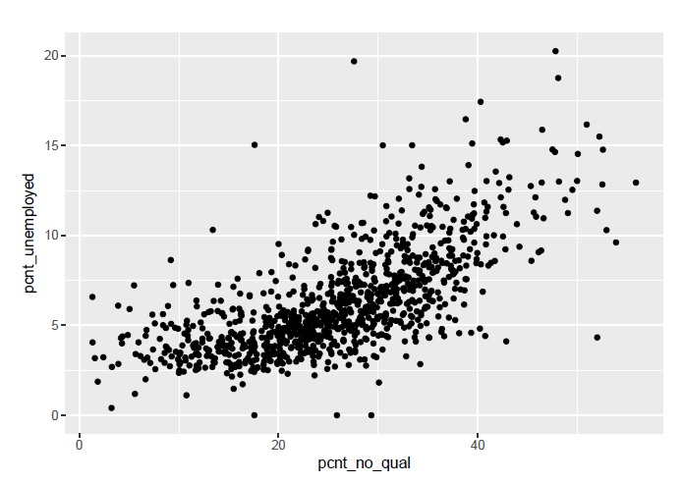
Scatterplots
Use when have two interval- or ratio-level variables; one on x-axis and one on y-axis

Slide 102
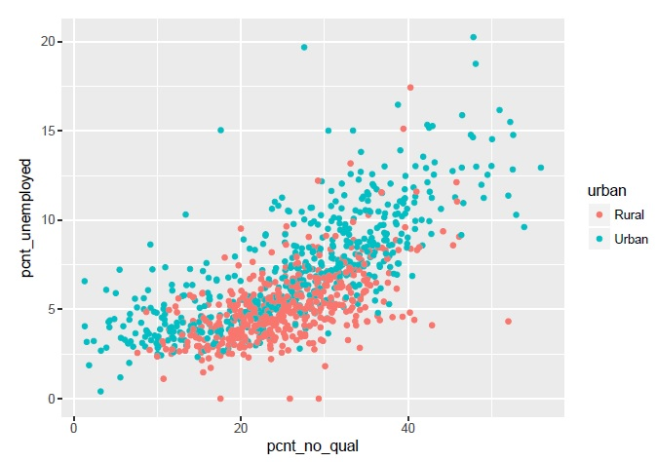
Scatterplots
Can include a third variable that is categorical using colours

Slide 103
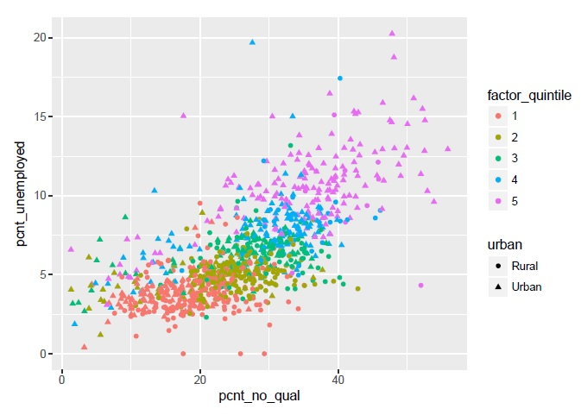
Scatterplots
Can include a fourth variable that is categorical using shapes

Slide 104
Quantitative Social Science Data with R: An Introduction
Brian Fogarty

Slide 105
Chapter 10
Bivariate analysis

Slide 106
Scope
Crosstabulations
Measures of association
Chi-squared analysis
Correlation analysis

Slide 107
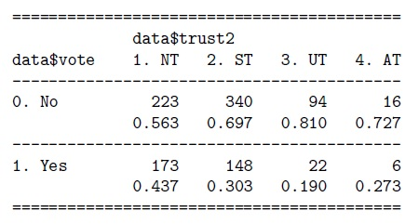
Crosstabulations
Frequency distributions of two variables with one specified as the outcome variable and one as the predictor variable
Prefer to use only with nominal- and/or ordinal-level variables
Table cells provide number of observations at specific values of the two variables
Typically include column percentages as well
From R:

Slide 108
Measures of association
Provides a specific measure of the strength and direction (sometimes) of a relationship between two variables
For ordinal variables, the measures range from – 1 to 1:
The sign tells whether it is a positive or negative relationship
The number tells the strength of the relationship
Rule-of-thumb:
0 – no association
.01–.3 – weak association
.31–.69 – moderate association
.70–.99 – strong association
1 – perfect association

Slide 109
Measures of association
When equal number of columns and rows use – Kendall’s tau-b
When unequal number of columns and rows use – Goodman & Kruskal’s gamma

Slide 110
Measures of association
If have at least one nominal variable, then need to use different measures
The measures range from 0 to 1:
Have no sign b/c cannot talk about positive or negative associations with nominal variables
The number tells the strength of the relationship
Rule-of-thumb:
0 – no association
.01–.3 – weak association

Slide 111
Measures of association
.31–.69 – moderate association
.70–.99 – strong association
1 – perfect association
Can use Cramer’s V

Slide 112
Chi-squared analysis
A statistical significance test commonly used in bivariate analysis; particularly with crosstabs
Tests how different our bivariate relationship is from a hypothetical no relationship
If the p-value is equal to or below .05, then the bivariate relationship is statistically significant
If the p-value is above .05, then the bivariate relationship is NOT statistically significant

Slide 113
Chi-squared analysis
Chi-squared does not tell us whether we have the “right” relationship
Does not control for other variables
Test statistic is inflated by sample size
Usefulness is in combination with measures of association and substantive discussion of crosstabs column percentages

Slide 114
Correlation analysis
Traditionally used as a measure of association between two interval- and/or ratio-level variables
Correlation does not imply causation
Most common is Pearson’s correlation:
Assumes a linear relationship between two variables
The correlation coefficient r is bounded between –1 and 1; interpret the same as the ordinal variable measures of association
r times r is called the coefficient of determination and provides the amount of variance explained in the outcome variable from the predictor variable

Slide 115
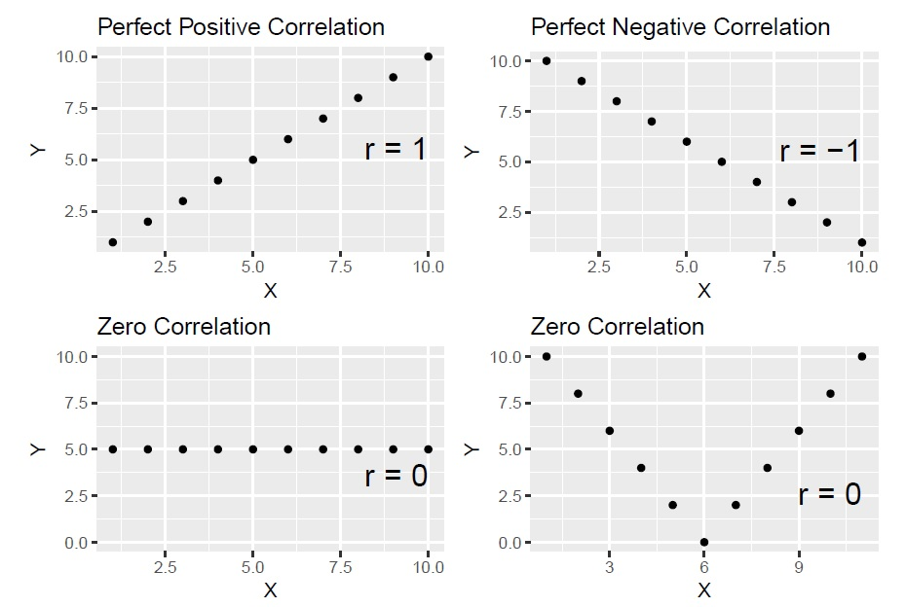
Correlation analysis: examples

Slide 116
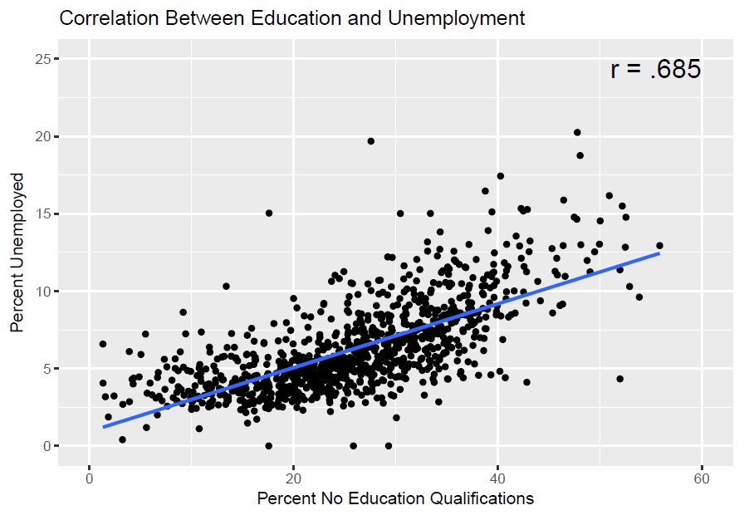
Correlation analysis: examples

Slide 117
Correlation analysis
Other correlation techniques do not assume a linear relationship
For example, Spearman’s correlation:
Only considers whether relationship is increasing or decreasing monotonically
Can also use ordinal-level variables
Coefficient is ‘rho’ and is bounded between –1 and 1; and interpreted the same as past measures

